Slide 1
Robots – Theory
Parts of Robot

Slide 2
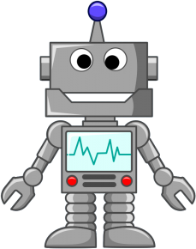
Introduction
Parts of a Robot
Robots can be made from a variety of materials including metals and plastics. Most robots are composed of 3 main parts:
Mechanical parts;
Sensors;
The Controller;

Slide 3
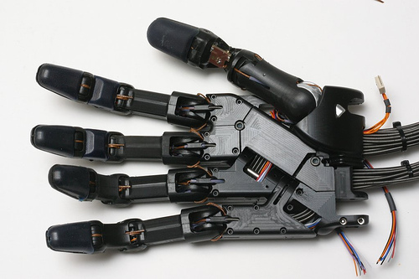
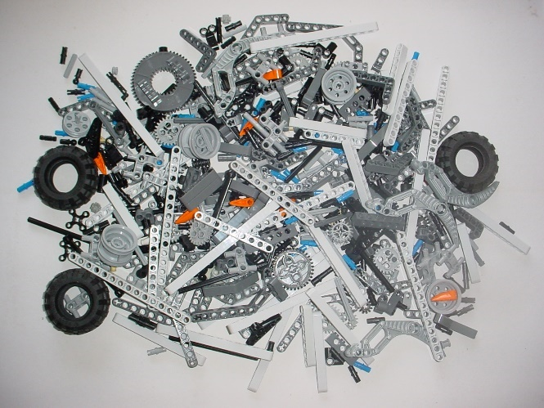
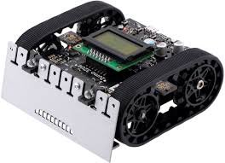
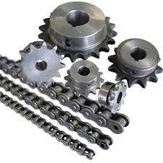
Mechanical parts;
Mechanical parts ‐ motors, pistons, grippers, wheels, and gears that make the robot move, grab, turn, and lift. These parts are usually powered by air, water, or electricity.

Slide 4
Mechanical parts - DC motors
A DC motor is any of a class of electrical machines that converts direct current electrical power into mechanical power. The most common types rely on the forces produced by magnetic fields. Nearly all types of DC motors have some internal mechanism, either electromechanical or electronic, to periodically change the direction of current flow in part of the motor. Most types produce rotary motion; a linear motor directly produces force and motion in a straight line.

Slide 5
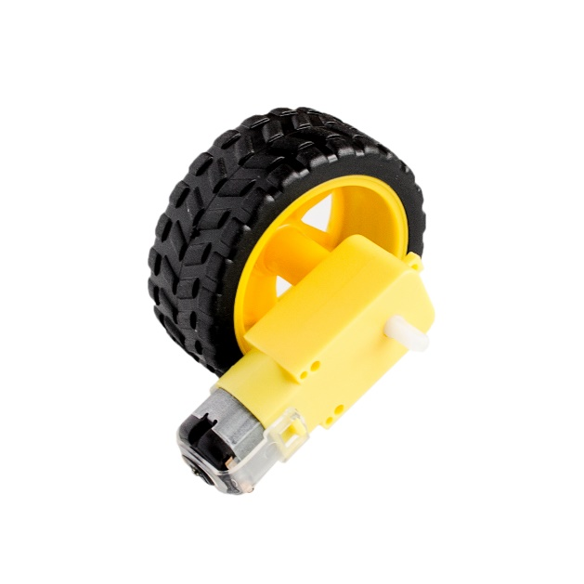
Mechanical parts - DC motors
The efficiency rating of a motor describes how much of the electricity consumed is converted to mechanical energy.
DC motors. Permanent-magnet DC motors require only two leads, and use an arrangement of fixed- and electro-magnets (stator and rotor) and switches. These form a commutator to create motion through a spinning magnetic field.

Slide 6
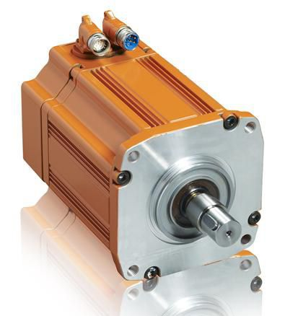
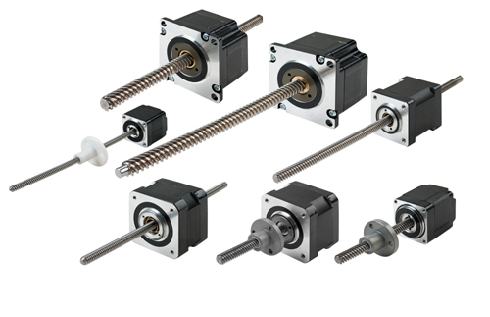
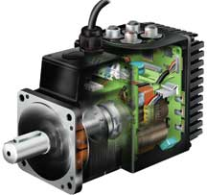
Mechanical parts - Motors
AC motors. These motors cycle the power at the input-leads, to continuously move the field.
Stepping motors. They are like a brushless DC or AC motor. They move the rotor by applying power to different magnets in the motor in sequence (stepped). Stepping motors are designed for fine control and will not only spin on command, but can spin at any number of steps-per-second (up to their maximum speed).
Servomotors. Servos are simple DC motors with gearing and a feedback control system. They adjust themselves until they match the signal. Servos are used in radio control airplanes and cars.

Slide 7
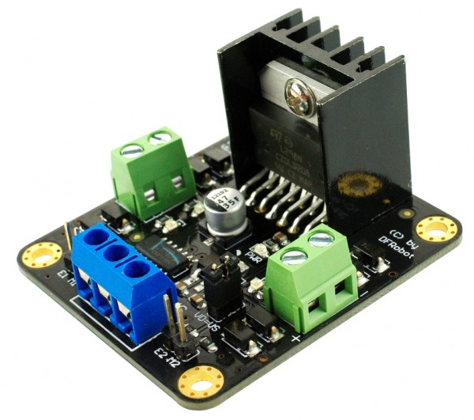
What is a Motor Driver?
A motor driver is a little current amplifier; the function of motor drivers is to take a low-current control signal and then turn it into a higher-current signal that can drive a motor.
Applications for Motor Drivers:
Motor drivers can be found in a wide
array of applications including:
Relay and solenoid switching
Stepping motor
LED and incandescent displays
Automotive applications
Audio-visual equipment
PC Peripherals
Car audios
Car navigation systems

Slide 8
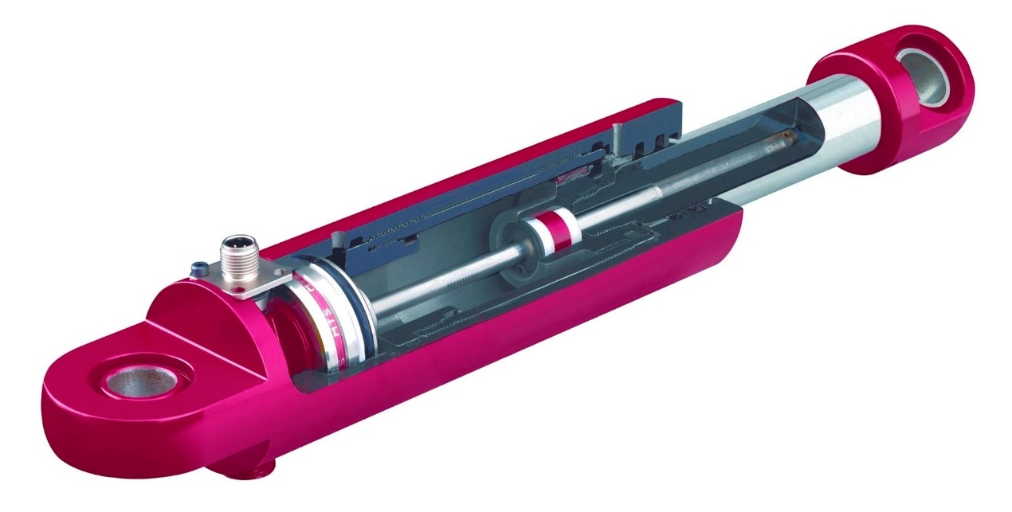
Hydraulics Parts
Both pneumatics and hydraulics are systems of pressurized fluids. The key difference is that pneumatic systems deal with gasses and hydraulic systems deal with liquids. Unlike gasses, liquids are incompressible.

Slide 9
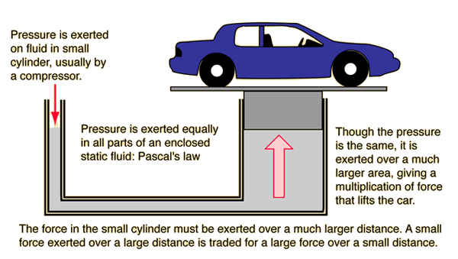
Hydraulics Parts - Pascal’s law
Under Pressure Pascal’s law describes how pressure acts upon liquids confined in a container. A consequence of all this is that you can get a mechanical advantage. When you apply a force to the small cylinder, the amount of force exerted by the large cylinder is proportional to the ratio of the surface areas of the two cylinders.

Slide 10
Robot Sensors
Sensors allow the robot to determine sizes, shapes, space between objects, direction, and other relations and properties of substances. Many robots can even identify the amount of pressure necessary to apply to grab an item without crushing it.
Robotic sensors are used to estimate a robot's condition and environment. These signals are passed to a controller to enable appropriate behavior.
Sensors in robots are based on the functions of human sensory organs. Robots require extensive information about their environment in order to function effectively.

Slide 11
Robot Sensors

Slide 12
Robot Sensors Classification
Sensors provide analogs to human senses and can monitor other phenomena for which humans lack explicit sensors.
Simple Touch: Sensing an object's presence or absence.
Complex Touch: Sensing an object's size, shape and/or hardness.
Simple Force: Measuring force along a single axis.
Complex Force: Measuring force along multiple axes.
Simple Vision: Detecting edges, holes and corners.
Complex Vision: Recognizing objects.
Proximity: Non-contact detection of an object.

Slide 13
Robot Sensors Classification
Sensors can measure physical properties, such as the distance between objects, the presence of light and the frequency of sound. They can measure:
Object Proximity: The presence/absence of an object, bearing, color, distance between objects.
Physical orientation. The co-ordinates of object in space.
Heat: The wavelength of infrared or ultra violet rays, temperature, magnitude, direction.
Chemicals: The presence, identity, and concentration of chemicals or reactants.
Light: The presence, color, and intensity of light.
Sound: The presence, frequency, and intensity of sound.
Motion controllers, potentiometers and encoder are used as joint sensors, whereas strain-gauge based sensing is used at the end-effector location for contact force control.

Slide 14
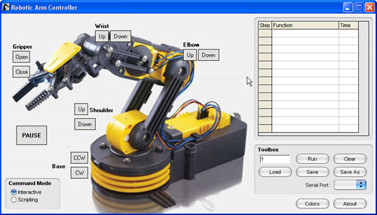
The Controller – Robot Software Control
Robot software is the set of instructions that tell a mechanical device and electronic system, known together as a robot, what tasks to perform. Robot software is used to perform autonomous tasks.

